Slide 1

Database Design
16 April 2026
Lynette Barnard

Slide 2
Where does a DB fit into an IS?
IS facilitates data collection, storage, transformation, retrieval
Database is…
Carefully constructed fact repository
Part of larger IS
Means to an end (not end in itself)
IS performance is dependent on
Database design and implementation
Application design and implementation
Admin procedures

Slide 3
Life cycles
Planning
Analysis
Detailed system design
Implementation
Maintenance
Database initial study
Database design
Implementation and loading
Testing and evaluation
Maintenance and evolution
Operation
Systems development
SDLC (Figure 10.2)
Iterative process
Databases
DBLC (Figure 10.3)
Chapter 10 & 11 - Database Design

Slide 4
Database design
Much of the content in this chapter consolidates design processes we’ve covered so far
Arguably most critical DBLC phase
Final product to meet requirements (user and system)
Two views
Business manager (what problems / solutions / information / data…?)
Database designer (how to structure / access / transform data…?)

Slide 5
Database design process (Fig 10.6)
Conceptual
Data analysis and requirements
ER modelling and normalisations
Logical
Map conceptual model to logical model components
Physical
Define data storage organisation
Data model verification
Distributed database design
Validate logical model using normalisation
Validate logical model integrity constraints
Validate logical model against user requirements
Define integrity and security measures
Determine performance measures
Select DBMS

Slide 6
Database security
Threats: potentially cause loss, misuse, harm (internal and/or external)
Sources of failure
Natural disasters, unauthorised access, employee sabotage, human error, poor database administration, …
Hardware, software, programming, transactions, external factors
Backup and recovery strategy
Full or differential or transaction log backup
Data are Users are
Protected Identifiable
Reconstructable Authorised
Auditable Monitored
Tamperproof
Desirable attributes of database security strategy (Martin, 1977)
Chapter 10 & 11 - Database Design

Slide 7
Database design strategies
ER modelling
Data sets to data elements
Normalisation
Data elements to data sets
Conceptual model
Entity
Attribute
Attribute
Entity
Attribute
Attribute
Top
Down
Bottom
Up

Slide 8
Design: Centralised or decentralised
Centralised
Small number of objects and procedures
Typical of relatively simple (not necessarily small) databases
Single designer can design and manage
NOT limited to small companies
Decentralised
Considerable number of entities and complex relations, complex operations
Often spread across several operational sites
Requires design team, working with several modules

Slide 9
Aggregation issues
Synonyms and homonyms
Know same object by different name (synonym)
Same name for different objects (homonyms)
Entity and entity subtypes
Subtypes can be viewed as separate entities in different departments
Conflicting object definitions
Different data types
Different domains
Varying constraint definitions

Slide 10
Conceptual design
Independent of software and hardware
Output of conceptual design is conceptual data model
Main data entities, attributes, relationships, constraints
Minimum data rule
All that is needed is there, and all that is there is needed
Steps you have already used
Data analysis and requirements
ER modelling and normalisation
Database design accomplished by design teams
Naming standards defined, documented and enforced
Proper documentation is crucial

Slide 11
Creating Logical data model – activities
Step | Activity
1 | Map strong entities
2 | Map weak entities
3 | Map multi-valued attributes
4 | Map binary relationships
5 | Map higher-degree relationships
6 | Map supertype/subtypes

Slide 12
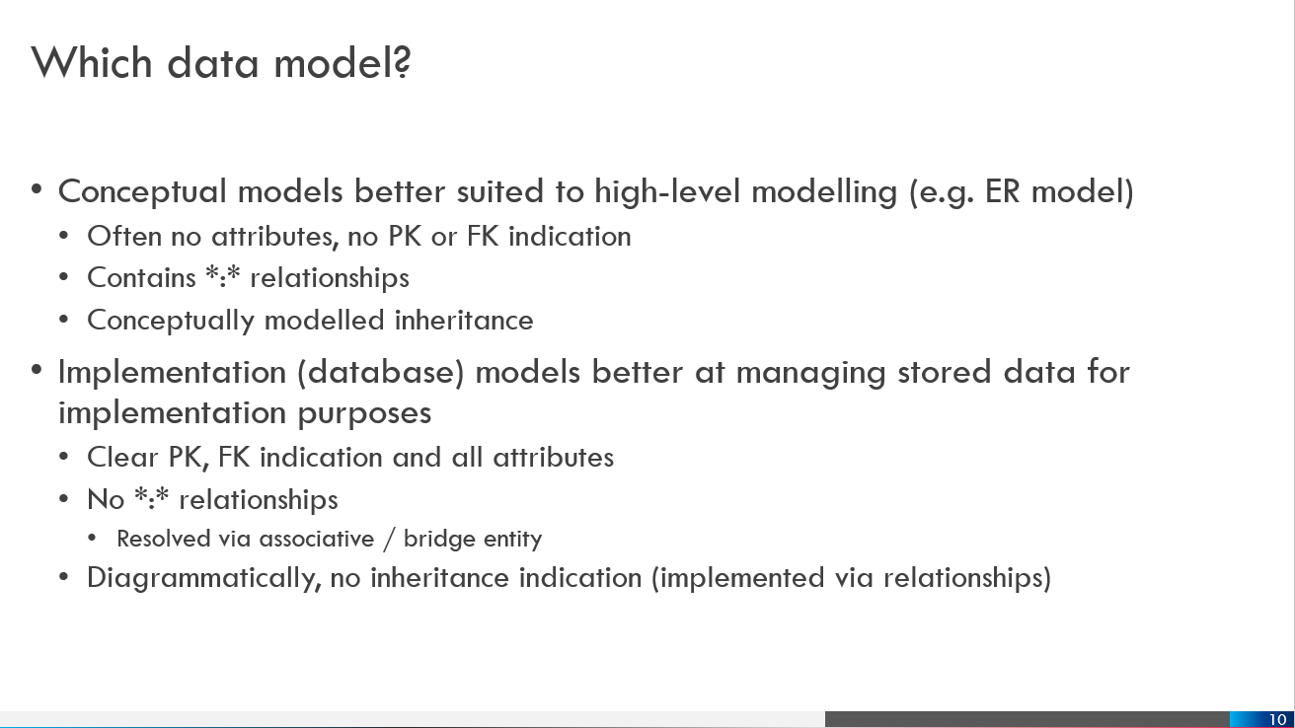
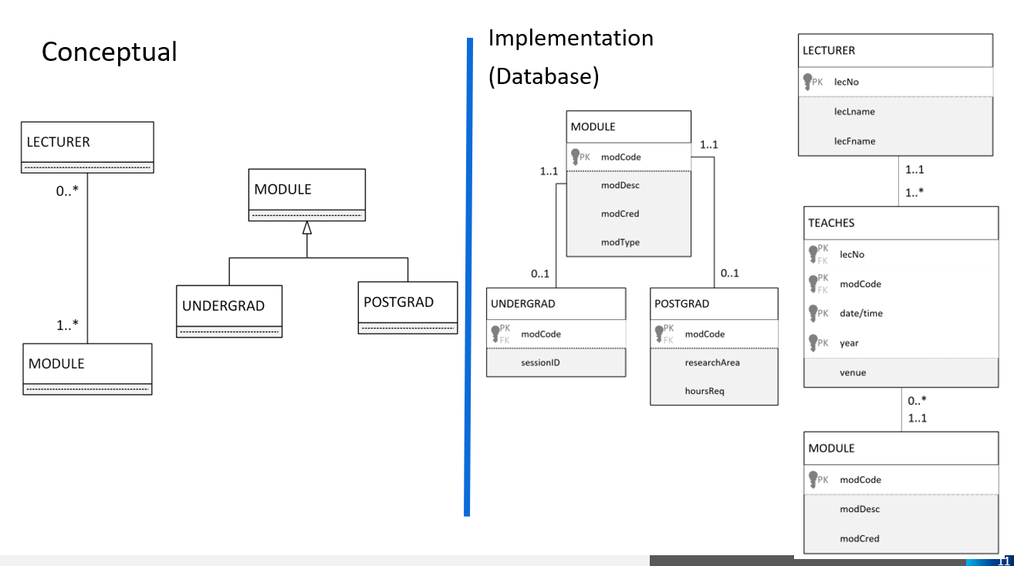
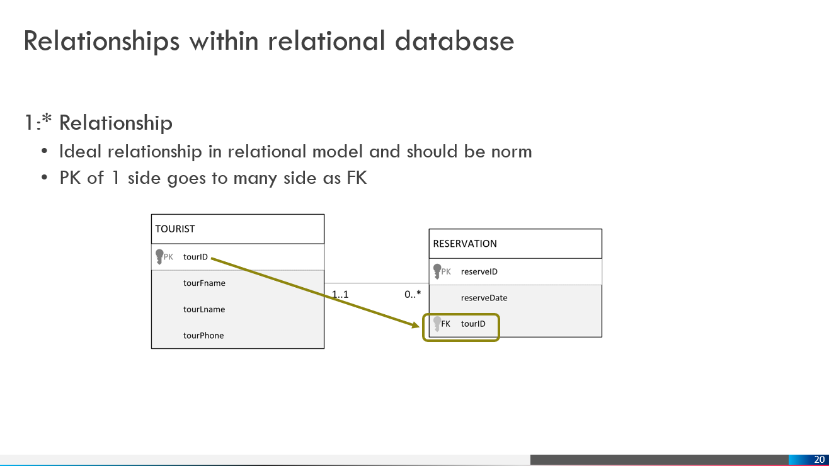
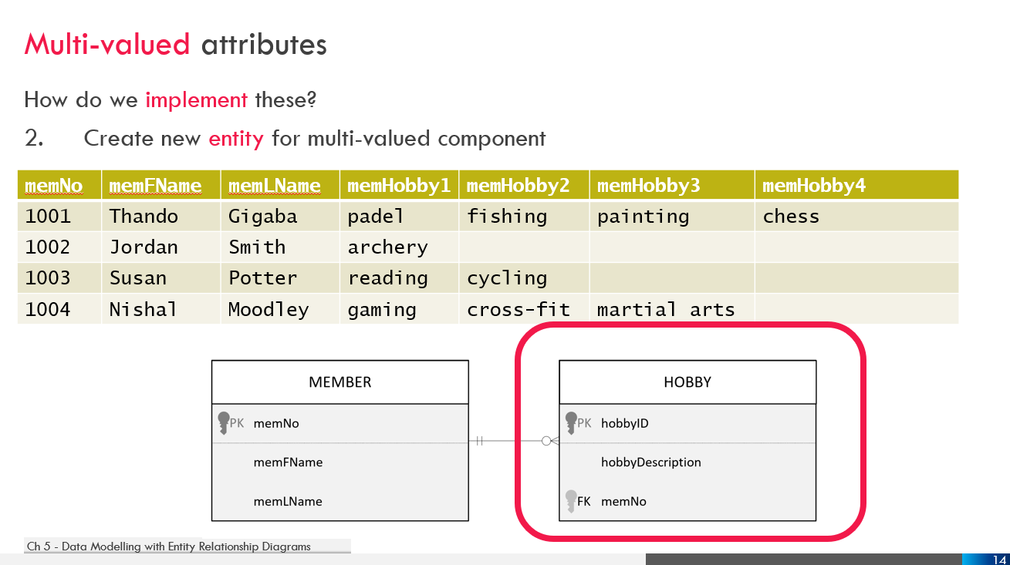
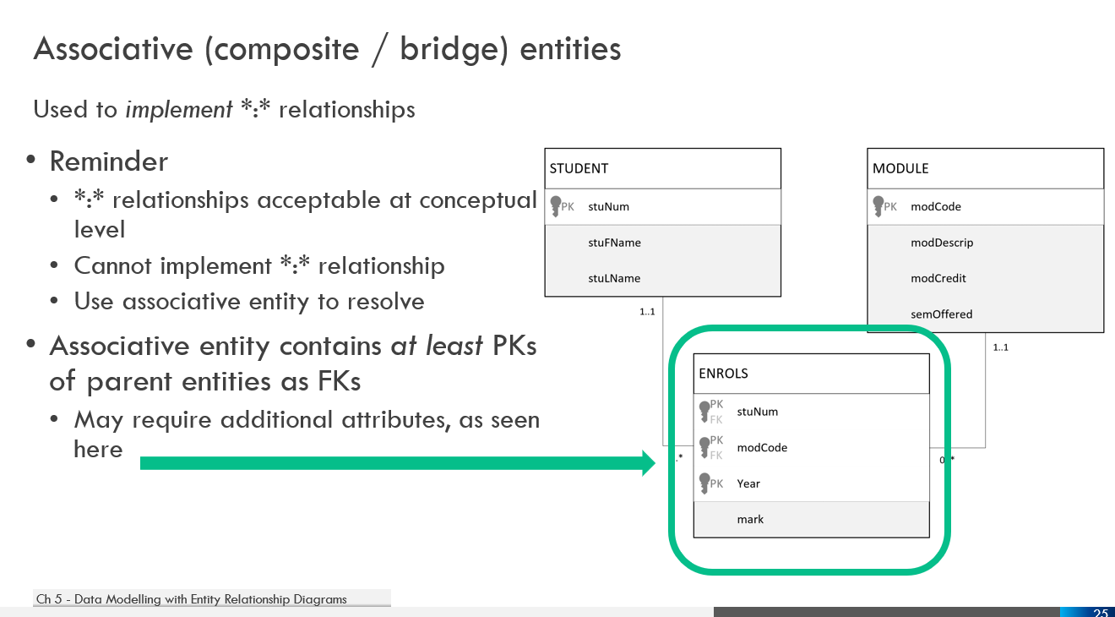
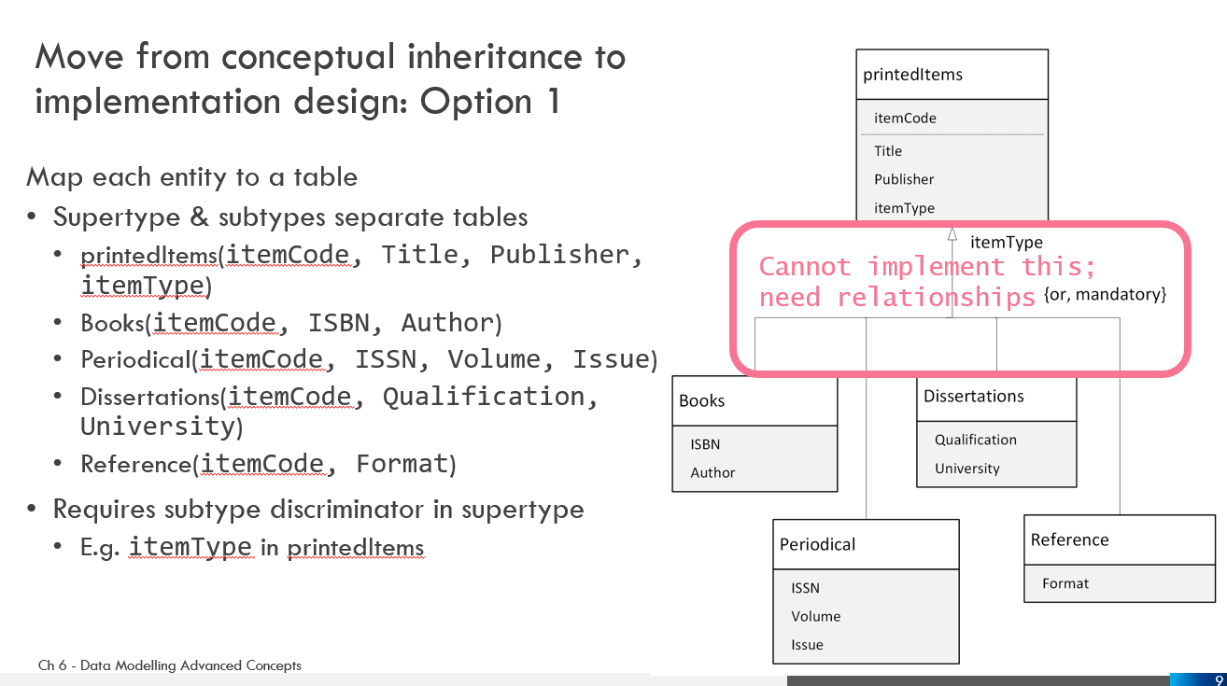
Re-cap on logical (implementation) design

Slide 13

Physical design: high index selectivity
Create index for single (i.e. not aggregated) attributes in
WHERE or HAVING or GROUP BY or ORDER BY
Index used when
Attribute is PK or FK
MAX or MIN function applied to indexed column
Data sparsity on indexed column is high (many different values)
Join column other than PK/FK
This Photo by Unknown author is licensed under CC BY-SA-NC.

Slide 14
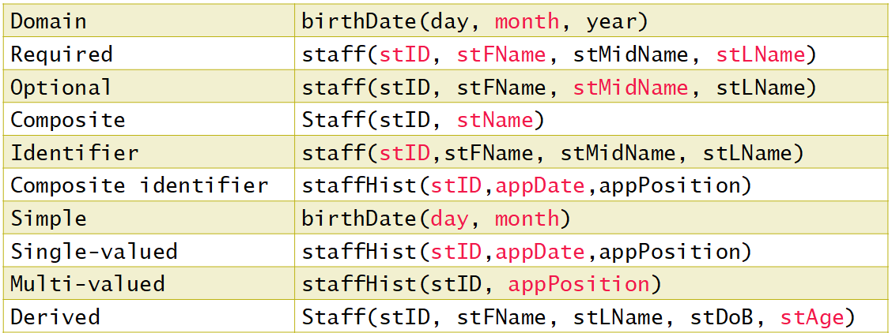
Assignment feedback
Three ways to implement
Need to refer to the tables, PKs and FKs
Carefully think about redundancy; don’t simply believe AI
Consider subtype discriminator; potential NULLs
Most appropriate – only based on what you were given
Create partial solution for Member and Dependant
Not atomic (i.e. you had a composite attribute) – needs to be a simple attribute

Slide 15

Semester test 2 – first notice
Schedule:
Tuesday, 12 May
May bring in ONE page (double sided) hand written (no photocopies) notes
2-hour test, 60 marks
Time to be confirmed – depends on lab availability (venues shared with another module this time)

Slide 16
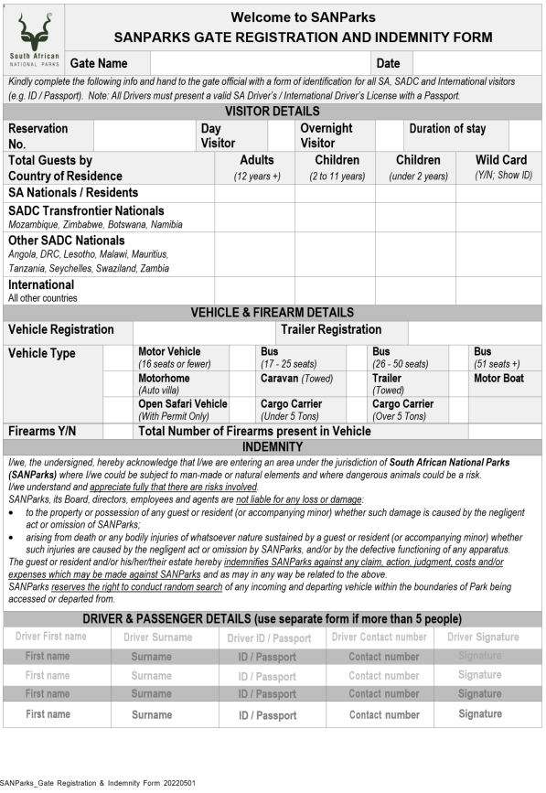
Database design class example – 07:45
Design a database to handle data on the form
Read scenario
What are main entities involved?
Relationships
PK / FK
Normalise entities
Verification – add additional entities where appropriate

Slide 17
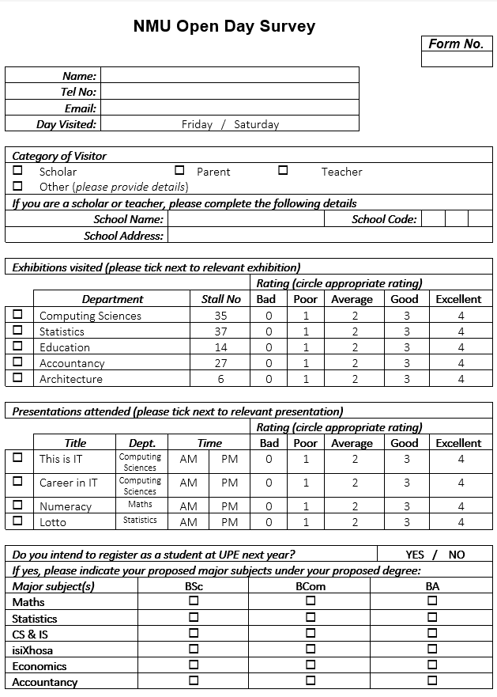
Database design class example – 13:05
Design a database to handle data on the form
Read scenario
What are main entities involved?
Relationships
PK / FK
Normalise entities
Verification – add additional entities where appropriate

